Slide 1
Understanding Measurement Based Care and Key Strategies for Seamless Implementation
Jeremy Weisz
CEO, Greenspace Mental Health
September 30, 2021
Notes:
Welcome, thanks for attending, introduce self and background.

Slide 2
Agenda
Learning Objectives
Introduction to Greenspace
What is Measurement Based Care?
Why Consider Measurement Based Care?
Case Study
Audience Discussion
Implementation Success
Perceived Implementation Barriers
Conclusion and Wrap Up

Slide 3
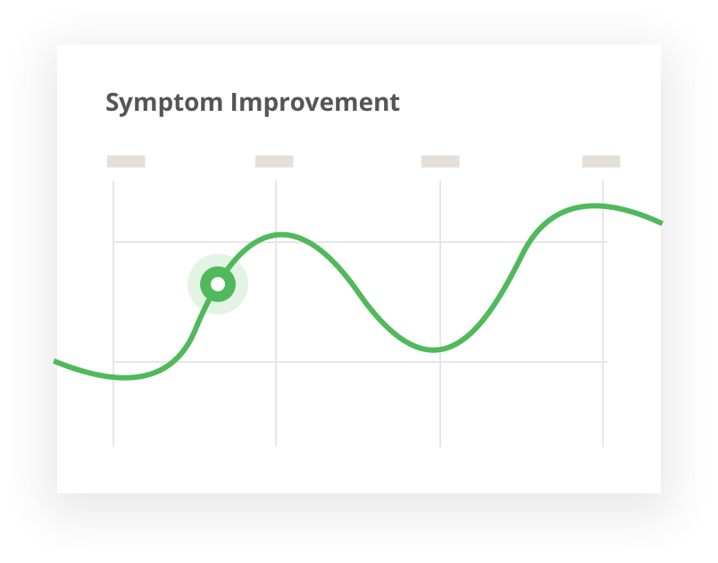
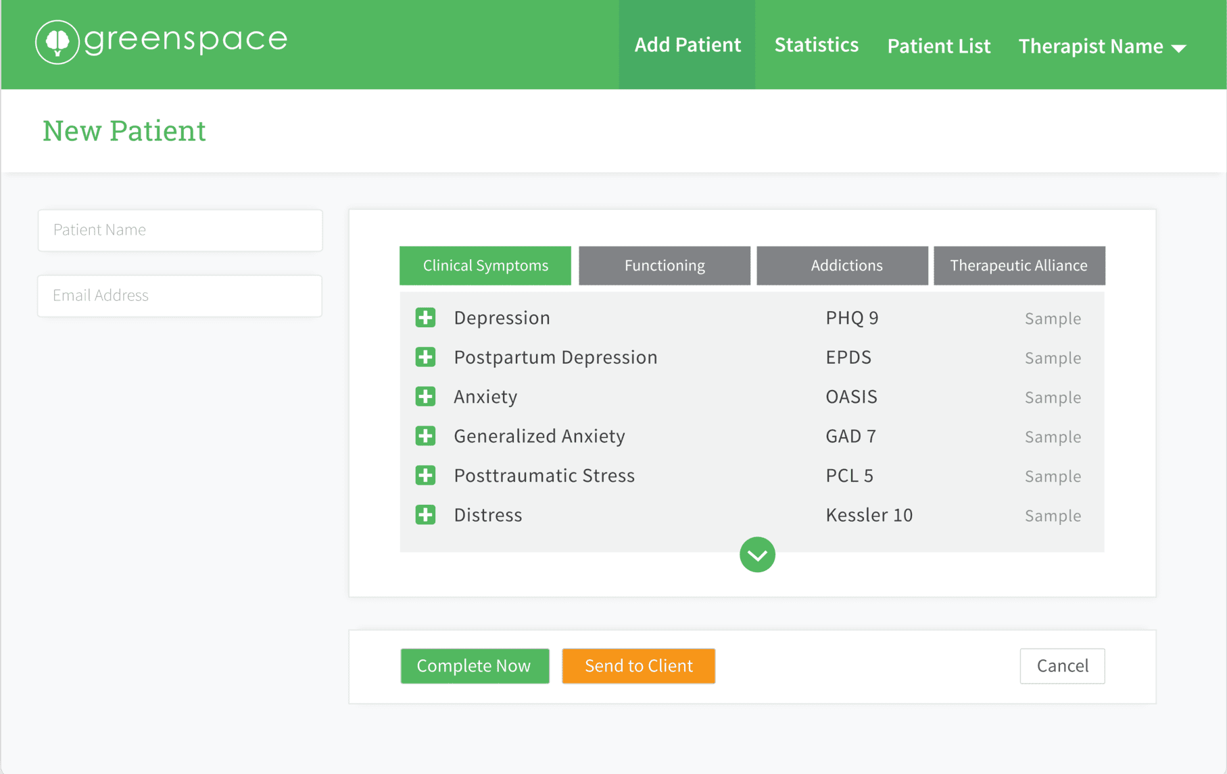
Introduction
Location: Based in Toronto and British Columbia, and serving all of North America
Existing Implementations:
7,500+ providers
250+ organizations
2m+ assessments completed
Enabling Measurement Based Care and more effective evaluation.
Notes:
Brief Greenspace Overview

Slide 4
Learning Objectives
Understand what Measurement Based Care is and the impact it has on client outcomes.
Outline the key elements required to successfully implement Measurement Based Care.
Understand the most common implementation barriers and how to successfully address them.

Slide 5
What is MBC?
KEY COMPONENTS OF EFFECTIVE MBC:
Measurement Based Care (MBC) is the routine collection and use of client-reported progress measures throughout treatment to guide clinical decision making (Scott and Lewis, 2015)
Consistent measures are routinely completed by a client during the treatment process.
Both the client and provider are able to access assessment results and symptom changes over the treatment period.
Provider uses data to inform the creation of a collaborative treatment plan for the individual client.
MBC is not intended to be a substitute for clinical judgement or replace a therapist’s method for decision making, but instead, supplements and supports the traditional process with additional objective information.
1. Lewis (2018) – Implementing Measurement Based Care in Behavioral Health:

Slide 6
Impact on Symptom Improvement
PATIENT IMPROVEMENT:
86.9%
vs.
62.7%
MBC has been clinically proven to accelerate symptom improvement in both youth and adults.
Measurement Based Care
Standard Care
The study found that when patient progress was measured in treatment, twice as many patients improved. In addition, at-risk patients stayed in therapy longer and were less likely to deteriorate (Lambert et al. 2001).
In a 2015 study, Measurement Based Care vs. Standard Care for Major Depression, the MBC group responded
better to treatment at a rate of 86.9% vs. 62.7% in the standard care Group.
The study also concluded that the MBC group saw symptom improvement in half the time compared to those of the Standard Care group.
Resource:
Measurement Based Care vs. Standard Care for Major Depression

Slide 7
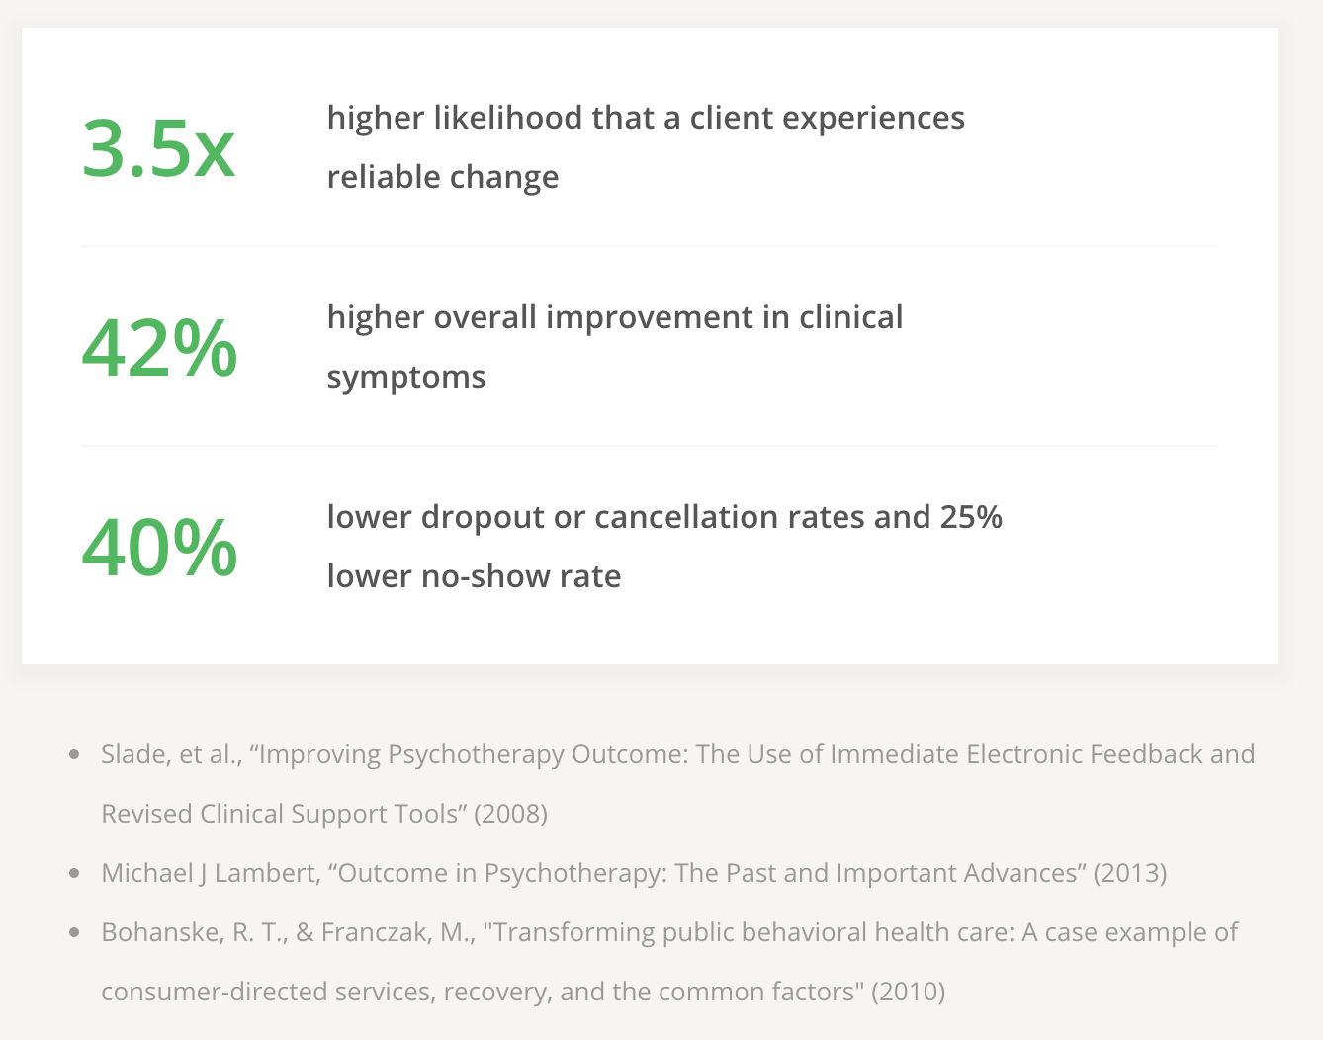
Why Consider MBC?
Four Key Benefits:
Increased patient engagement.
Improved communication and higher overall improvement in clinical symptoms.
Earlier detection of health changes resulting in a higher likelihood that a client experiences reliable change.
Reduced provider bias.

Slide 8
A Tool to Improve Client Engagement
The practice of displaying and making progress results accessible to clients helps to create transparency and better engages clients in their treatment plan.
Studies show that administering an outcome measure reduces client cancellations and no-show rates throughout treatment (Bohanske & Franczak, 2010).
MBC can also be used to strengthen the therapeutic relationship between client and provider, resulting in a more informed and engaged client
who can participate meaningfully in shared decision making. ²
Clients who regularly complete assessments are likely to become more knowledgeable about their disorders, attuned to the fluctuation of their symptoms over time, and cognizant of the warning signs of relapse or recurrence.
MBC has been shown to reduce patient cancellations, no show rates, and increase therapeutic relationship between provider and patient.
2. Fortney (2015) – A Tipping Point for Measurement Based Care

Slide 9
Assists in Identifying Symptom Severity
and Targeted Focus Areas
Adjusting treatment plans based on symptom measures and outcomes is an important component of collaborative care.
Consistent measured results allows providers to gain a better understanding of whether the client is having a full response, partial response, or no response to treatment. This provides clinicians with visibility into symptom improvement or deterioration which allows them to more accurately adjust treatment.
In addition to more target treatment focus areas, MCB can also assist clinicians in
tracking and measuring symptom severity.
When used consistently, measures serve the purpose of characterizing self-reported severity of symptoms over the entire course of treatment. Clinicians can then use this information to adjust treatment plans based on symptom severity results.
Resource:
MCB is not intended to be a substitute for clinical judgement or replace a therapist’s method for decision making, but instead, supplements and supports the traditional process with additional objective information.
3. AIMS Center - Measurement Based Treatment to Target

Slide 10
Case Study: Pathstone Mental Health
“
The shift to measurement-based care with Greenspace unequivocally allowed Pathstone to improve treatment. We have seen satisfaction scores go up. We are seeing reduced times in service. Higher levels of engagement. And better outcomes.
— Erin Clayton, Clinic Manager
Using Measurement Based Care to increase client engagement and reduce dropout
RESULTS:
82%
20%
25%
Increase in therapeutic engagement
Reduction in dropout rates
Estimated savings in staff indirect time
PROBLEM:
Data quality collected from pre/post
Client and clinician buy-in
Staff time away from direct service

Slide 11
Audience Discussion
Question #1
Are you using Measurement Based Care in your clinic?
If you are, what prompted you to start?
If you aren’t yet, why not?

Slide 12
Audience Discussion
Question #2
What assessment tools or measures do you use today?

Slide 13
Audience Discussion
Question #3
Does your clinic monitor for off-track clients?
If yes, how do you monitor for clients who are not on track and what do you look for?
Notes:
Is there any way to identify and respond to a client who is likely to drop out of care or deteriorate?
How do you currently keep patients on track and engaged in the process?

Slide 14
Audience Discussion
Question #4
Do you/your clinic have a strong therapeutic alliance with your clients?
How do you work to strengthen the therapeutic alliance between client and provider?
Notes:
How many clients work with other healthcare providers before/after/in tandem with you?
How are you currently sharing information?

Slide 15
Audience Discussion
Question #5
Do you share aggregate outcome data with funders, boards and other key stakeholders?
What type of information are you currently sharing?
What do you wish you could share?
Notes:
If yes, what type of information do you need / want to report?

Slide 16
Audience Discussion
Question #6
Are there any other barriers or challenges that come to mind for you in implementing this model into practice?

Slide 17
Successfully Implementing MBC
Communicating the value and rationale behind Measurement Based Care with your clinicians.
Providing clear guidance on how MBC fits within the clinic’s workflow and who is responsible for what (ie. client, therapist, admin).
Coaching clinicians on how to introduce the concept of Measurement Based Care to clients.
Giving clients visibility into their outcomes and progress.

Slide 18
Perceived Implementation Barriers
Does MBC replace
clinical judgement?
Let’s discuss some of the most common perceived barriers to implementing Measurement Based Care – and how organization have successfully addressed them.
Will the Clinic Directors
be reviewing all of
my notes and cases?
Is this new process going to add to my already full workload?
Will my clients engage and want to complete assessments?
Is the data clinically useful?

Slide 19
Perceived Barrier #1
Measurement Based Care replaces the clinical judgement of clinicians.
Myth
MBC is a tool that helps inform the clinician’s clinical judgement and decision-making; not replace it.
Reality

Slide 20
Perceived Barrier #2
Measuring outcomes is a way for managers to implement performance management for clinicians.
Myth
MBC is used to develop a culture of learning internally, with the focus on using it to better serve clients, not for performance management of clinicians.
Reality

Slide 21
Perceived Barrier #3
It takes too long to facilitate Measurement Based Care with every client.
Myth
If properly planned and implemented, MBC can easily be structured in a way that does not increase clinician workload. Clarity on process and certain automation tools are key.
Reality

Slide 22
Perceived Barrier #4
Measurement Based Care isn’t actually clinically useful. The primary reason for doing it is for data collection.
Myth
MBC exists to help drive better care, not as a data collection exercise. A key component of implementation is that its clinical value is understood by clinicians.
Reality

Slide 23
Perceived Barrier #5
Clients won’t want to participate and complete assessments.
Myth
Clearly communicating ‘why’ measurement based care is important – results in the large majority of clients being excited about participating.
Reality

Slide 24
Conclusion
Measurement Based Care has the potential to have a profound impact on the quality of care across the country.
Thank you for your interest in learning more about it.
More Questions?
Jeremy Weisz: Email: jeremy@greenspacehealth.com
Web: greenspacehealth.com/measurement

