Slide 1
RCPA 2021 Coping together… Angela Chew, LCSW
Coping through the pandemic as a community

Slide 2
Objectives:
Recognize the stressors and threats to safety and vulnerability the pandemic has created for communities and agencies.
Identify ways to assess needs and develop comprehensive approaches to coping as a community.
Designing responses to needs in a trauma informed culture.

Slide 3
What has the pandemic led to?
Stress
From constant information
From frequent changes
From financial concerns
From health concerns
From holidays
From family concerns

Slide 4
Who has been affected by the stress created by the pandemic?
Everyone

Slide 5
What is the root of the stress?

Slide 6
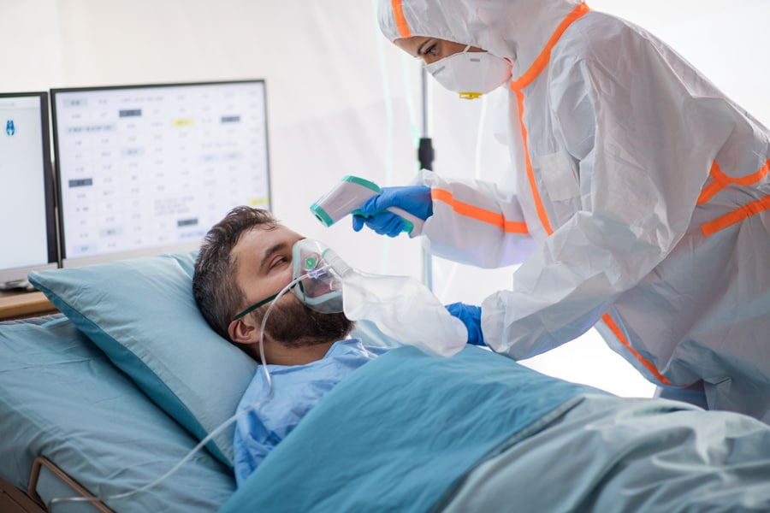
How has the pandemic affected the 5 types of safety?
Physical Safety
Fear of illness
Fear of death
Difficulty to physically engage in every day tasks
Financial stability and security

Slide 7
Safety and Pandemic
Emotional/Psychological Safety
Emotional management of constant change
Emotional management of constant crisis state
Emotional management of depression and anxiety which co-occurs with social isolation
Grief and loss issues
Worries about finances
Increased risks of vicarious trauma

Slide 8
Safety and Pandemic
Intellectual Safety
Contradicting information about COVID
Changing rules and protocols
Difficulty with focus and concentration
Fear of making mistakes
Understanding and using technology
Mental exhaustion of each day

Slide 9
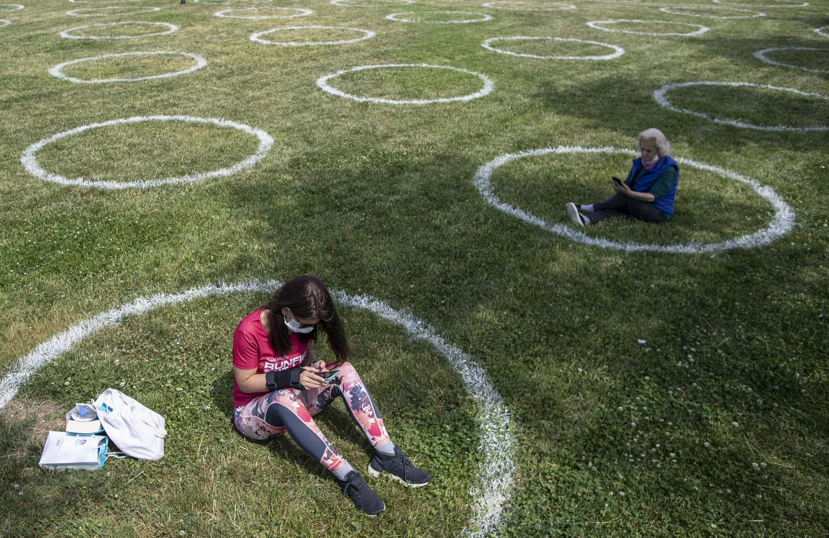
Safety and Pandemic
Social Safety
Separation from family
Separation from other loved ones
Inability to interact with others in a direct way
Lack of human touch and forced isolation
Fear and concerns of loss
Fear of others on a daily basis

Slide 10
Safety and Pandemic
Ethical/Moral/Spiritual Safety
Ethical dilemmas compounded by virtual education, telehealth, and virtual business
Extensive procedures to follow for safety
Individuals in public not following the “rules”
Unable to access spiritual practices in the same way
Conflicts which create division in the midst of the pandemic, such as politics, racial injustice, etc.

Slide 11
How do we respond to the
threat to safety?

Slide 12
“Put on your own oxygen mask first”

Slide 13
How do we respond to consumers and the community?
Establish a plan to safely continue services
Identify the needs of the community
Assess resources available
Develop a plan to provide support to the community

Slide 14
What did we do?
Engage in telephonic and telehealth services to ensure any level possible of continuity of care
Establish an assistance hotline to help vulnerable and distressed community members access basic needs:
- deliver groceries, cleaning supplies, hygiene supplies
- deliver medications
- guide and connect to other community resources
- provide a take out meal to the community members
- just talk to worried and distressed individuals

Slide 15
What did we do to reach others in the community?
Went Virtual Of Course!

Slide 16
Continued support of the community…
Maintained services in the safest possible manner as authorized
Supported and trained teachers in coping with COVID in-services
Listened to the community’s needs and try to respond
Continued to field calls on the support hotline for as long as able to help direct the community to available resources

Slide 17
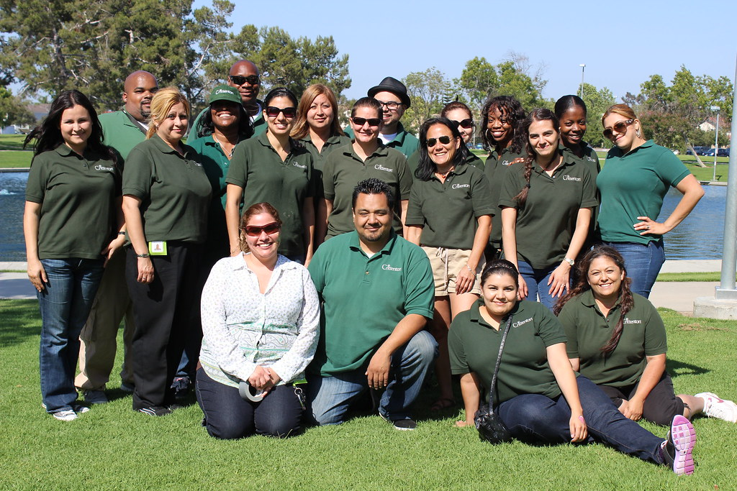
Wait…staff are also
community members.
How do we support them?

Slide 18
Staff experience navigating work and living in the community through pandemic…
Design a survey to assess the needs of the staff (survey in handouts)
Review the results and respond according to staff needs and compared baselines from ProQoL (research posters with results over time in handouts)
Provide training to supervisors to cope with own stress and to help support staff and respond to stress in a trauma informed manner. (sample slides to follow of the training)
Developed a staff stress support group over zoom.

Slide 21
Sample of training slides

Slide 22
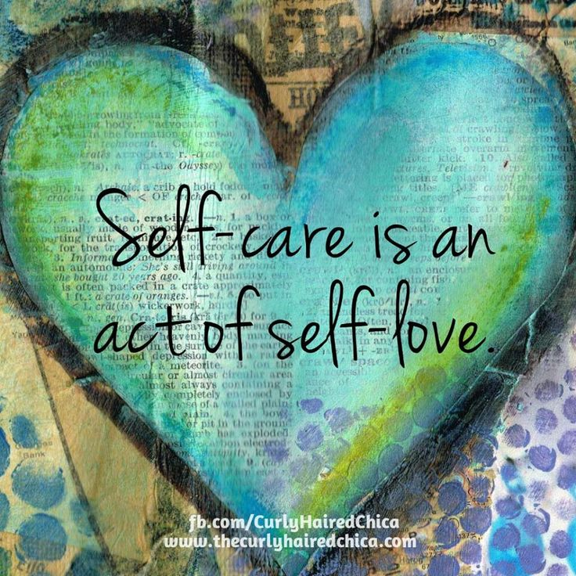
Self-Care is critical
Get rest
Eat properly
Move around and get brief exercise
Keep alcohol use to a minimum
Scheduled time for self
Develop a ritual to clear your mind
Engage your family/friends/pets
Laughter and humor
Remember your switch
Ask for help

Slide 23
Just breathe before responding, reacting, review, …
When we are anxious or feel threatened our breathing speeds up in order to get our body ready for danger
Relaxed breathing (aka – abdominal or diaphragmatic breathing) signals the body that it is safe to relax.
Relaxed breathing is slower and deeper than normal breathing and it happens in the lower body ( the belly rather than the chest)

Slide 24
When you find you are overly worried or stuck thinking about something ask yourself these questions:
1. What is the situation I am worried about?
2. How likely is this to happen?
3. Have I felt or experienced something similar in the past?
4. How did I cope with my worry in the past?
5. What was helpful?
6. What was not helpful?
7. What part of this can I control or manage? How can I control or manage this?
8. Who can I ask for help or support?
9. Engage in what has been helpful in the past and focus on what is in your control and likely to happen.

Slide 25
Maintain social connectedness
Maintain your regular activities or meetings, encourage maintaining social connectedness while maintaining safety:
Video and phone check-ins
Celebrate little things
Video meetings over lunch
Work together on a project
Team building remotely

Slide 26
Embrace positivity and avoid negativity
Begin the day with positive thought or encouraging words
End the day with what went well and what we are thankful for
Acknowledge and thank all efforts and accomplishments
Try not to spend to much time immersed in news, only enough to have basic information.
Avoid negativity and complaining when possible and seek solutions and resolutions to problems
Engage the team in new creative projects to stimulate energy and future focus.

Slide 27
Relaxation can help (activity)

Slide 29
Name and honor feelings
Check in with staff individually and as group
Engage something like a community meeting to get a sense of the feelings of the team and the individuals in the team.
Ask How are you feeling today? (provide lists of feeling words, name the feeling only not explain the feeling, temperament of the person and/or the group)
What is your goal for today? (helps to focus on tasks, allows others to know how to support or help)
Who can support you today? (makes it easier to ask for help and helps to know who folks believe they can rely upon)

Slide 30
“Put on your own oxygen mask first”

Slide 31
QUESTIONS?
THOUGHTS?
DISCUSSION, FEELINGS, FEEDBACK?
References noted in literature review developed by Dawn Woods (MPH Intern)

Slide 32
Contact me:
Angela N. Chew, LCSW, Program Director
Dickinson Restoration Center
Dickinson Center, Inc.
200 Service Center Road
Brookville, PA 15825
814-776-0236
achew@dickinsoncenter.org

