Slide 1
Recovery is Beautiful
Vicki Church, CRS; Hillary Palczer, CRS
Mandy Fauble, PhD, LCSW; Jessiann Montie, LPC, CAADC
Safe Harbor

Slide 2
Objectives
Define recovery capital
Describe the role of recovery specialists in building recovery capital
Identify opportunities to improve recovery-based language in substance use disorder services

Slide 3
Vicki’s Journey

Slide 5
Family…

Slide 7
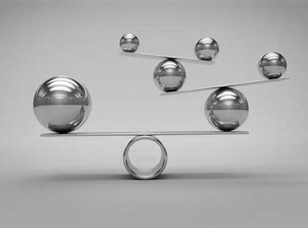
Recovery Capital
“internal and external assets that can be brought to bear to initiate and sustain recovery from alcohol and other drug problems”
Recovery Capital Scale (williamwhitepapers.com)
Using the Assessment Recovery Capital at an Addiction Treatment Centre: A Pilot Study to Validate Utility | ARC Journal of Addiction (arcjournals.org)

Slide 8
Why Consider?
SUD services remain infused with deficit based approach
Asset based
Trauma informed
Improved odds of sustainability with more resources
CBT/SFT – mastery, what’s working
May engage and help reconcile needs
Ethic of care
Community role
Policy role

Slide 9
Types of Recovery Capital*
Personal
Family/Social
Community
Cultural
Can we also apply to organizations and staff?
*terms may vary

Slide 10
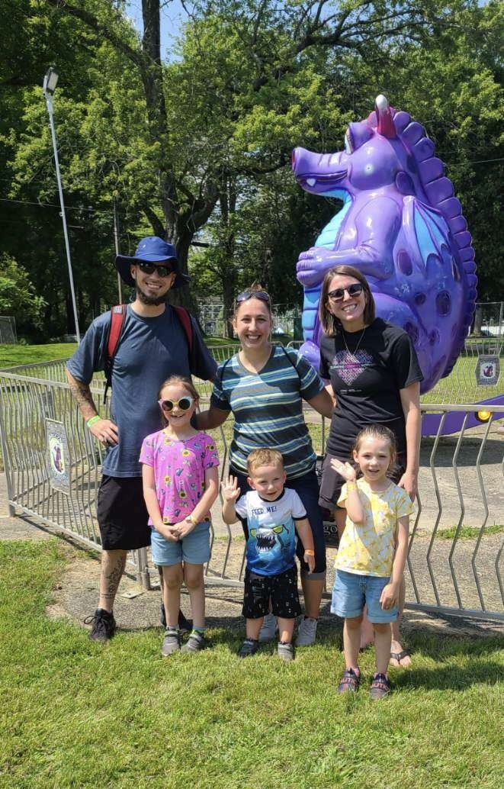
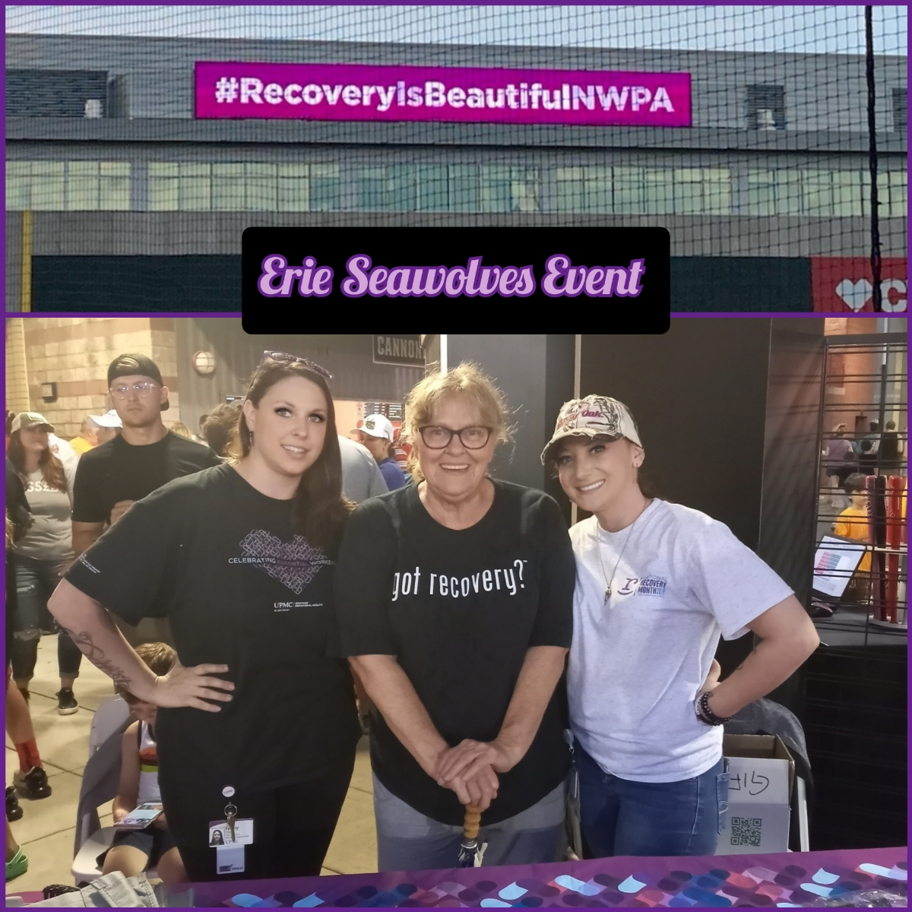
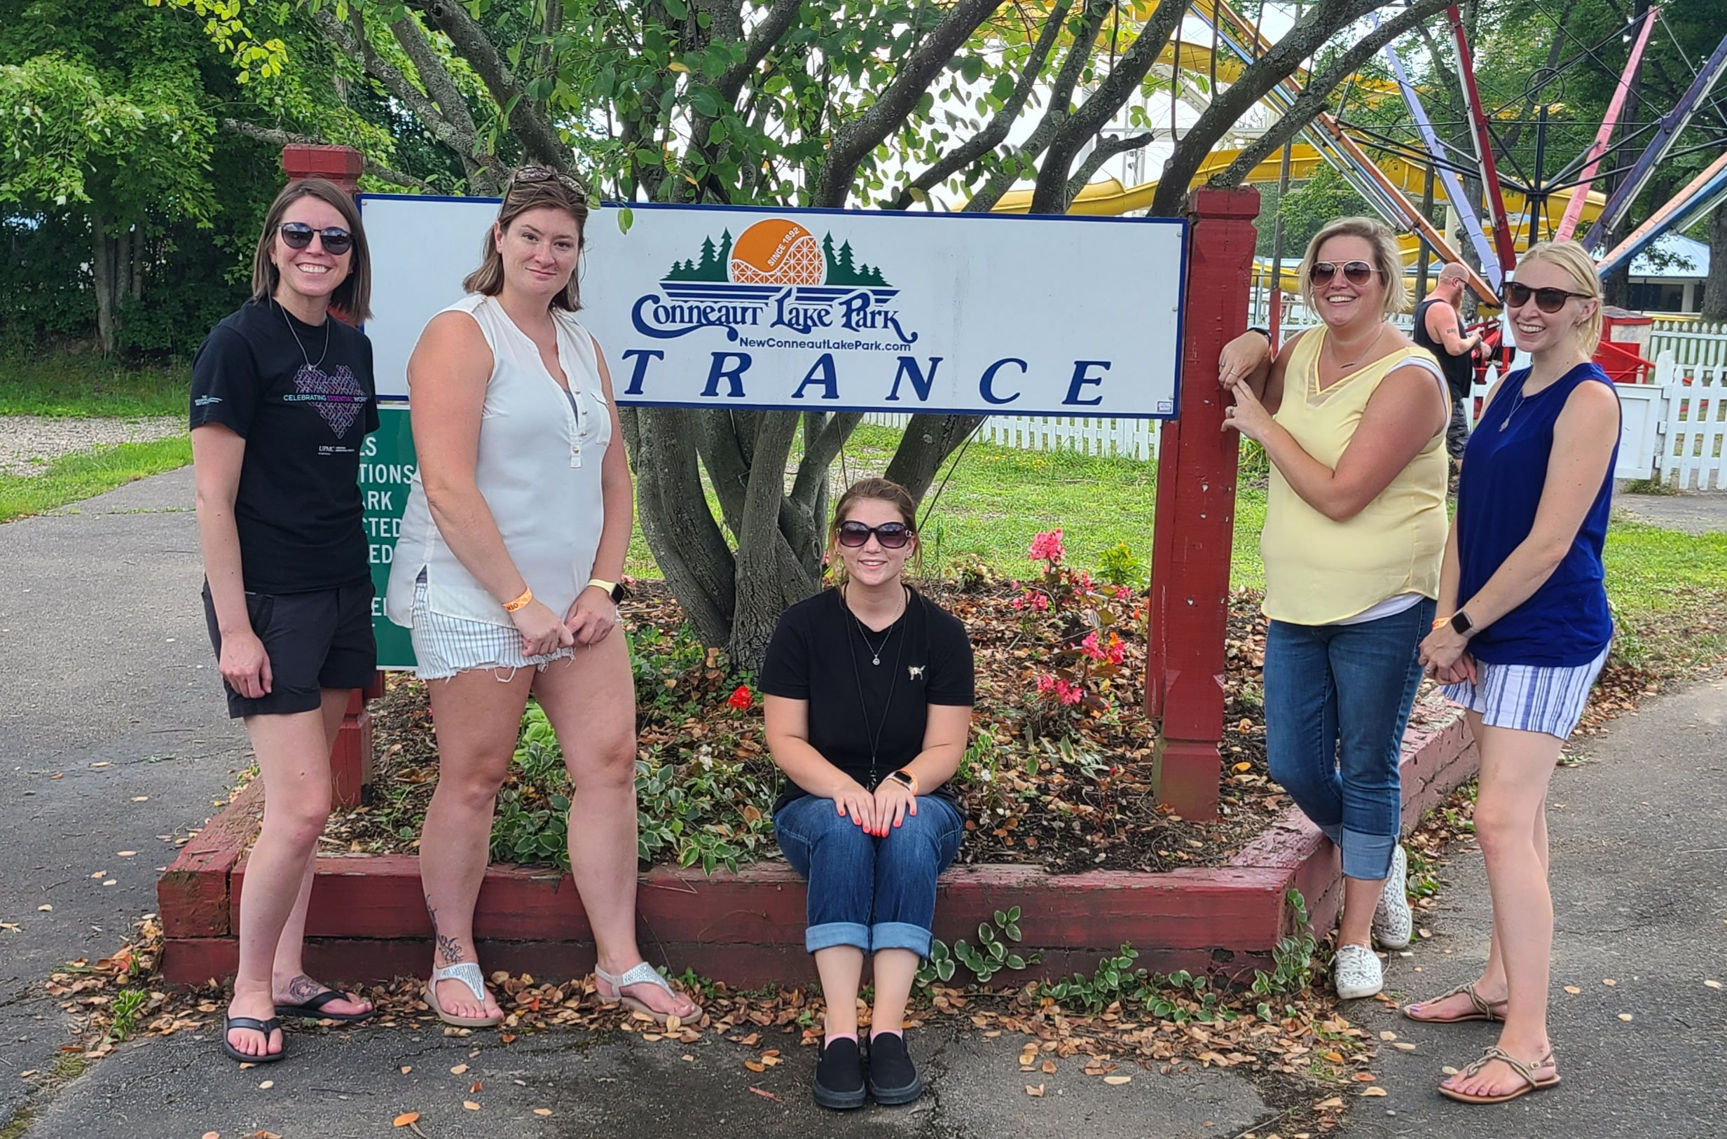

Slide 11
Life Skill Groups - designed to encourage personal insight and empower women and their families to remove barriers and meet recovery goals.
Rock’n Recovery-weekly group program for individuals in recovery. In this program, we review topics like:
How to budget
Resume building
Health tips
Boundaries
Daily living skills
Growing Together is a group for individuals in recovery and their families. The group meets virtually every week to talk about things parenting and social development, stress management and family strength skills.
Family Support Groups
The Family Support Group meets every other week online to offer education, comfort, encouragement, and support from others who truly understand.
Sober Social Events
We offer a wide range of FUN sober activities for individuals and families in Erie, Crawford, and Venango Counties. Activities have included a day at the zoo, a night at the Seawolves, Tuesday night walking, hiking, and more!
Women’s Support Group meets weekly, in person or virtually, to talk about red flags in recovery, how to cope with past trauma, and dealing with impulsiveness, as well as working on Vision Notebooks.

Slide 12
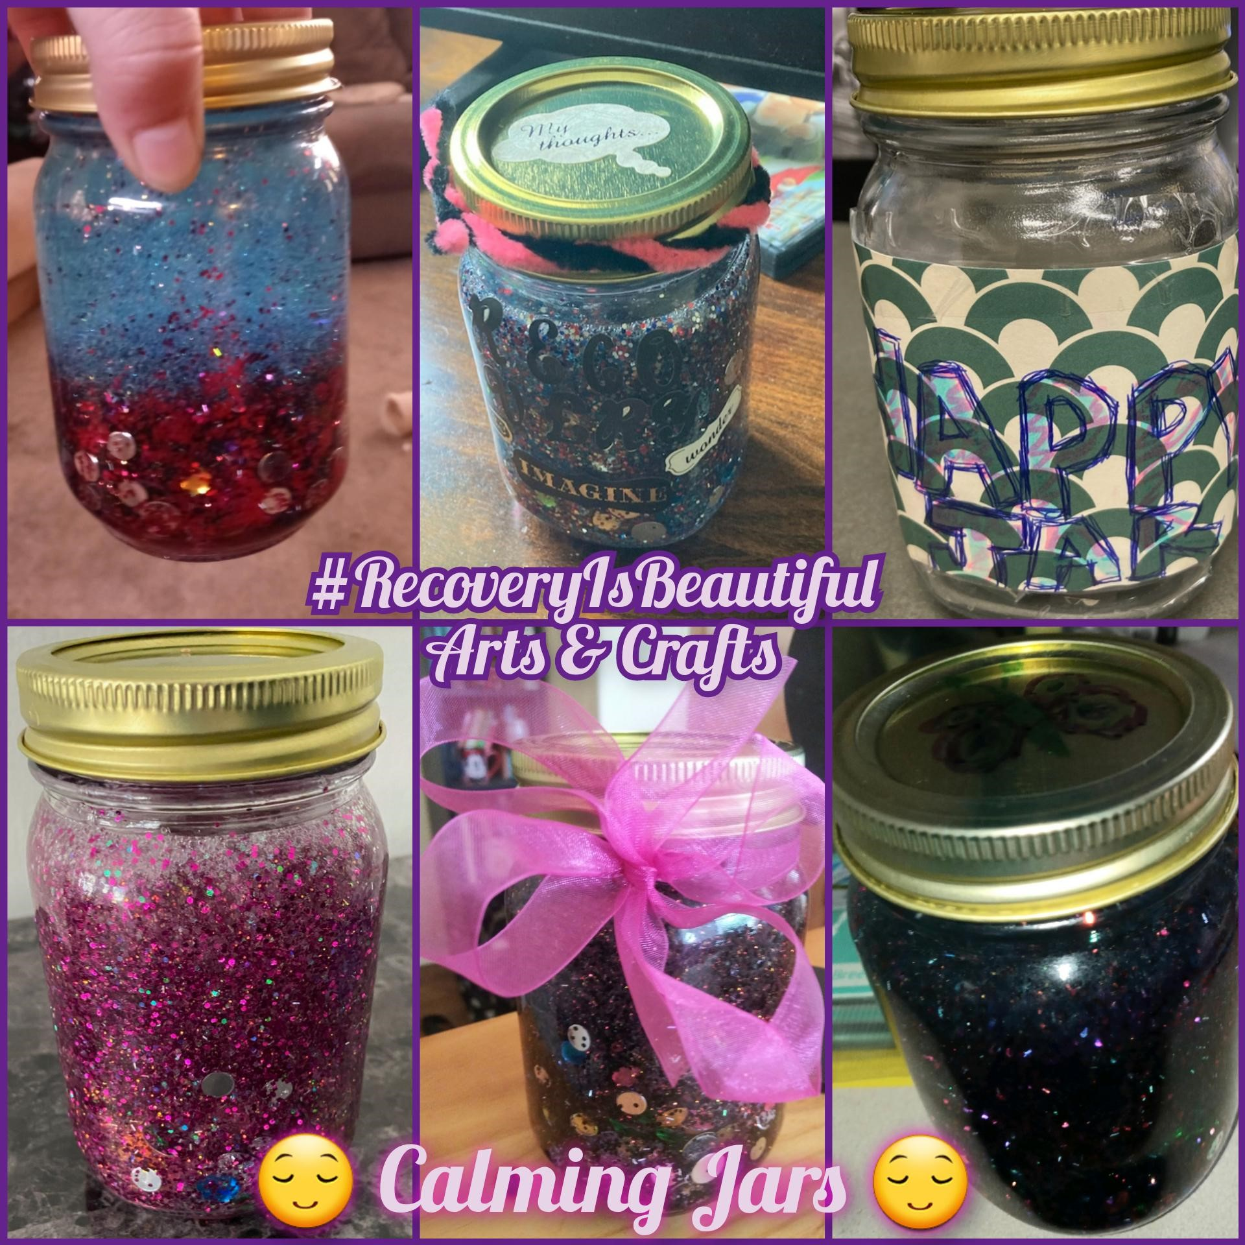
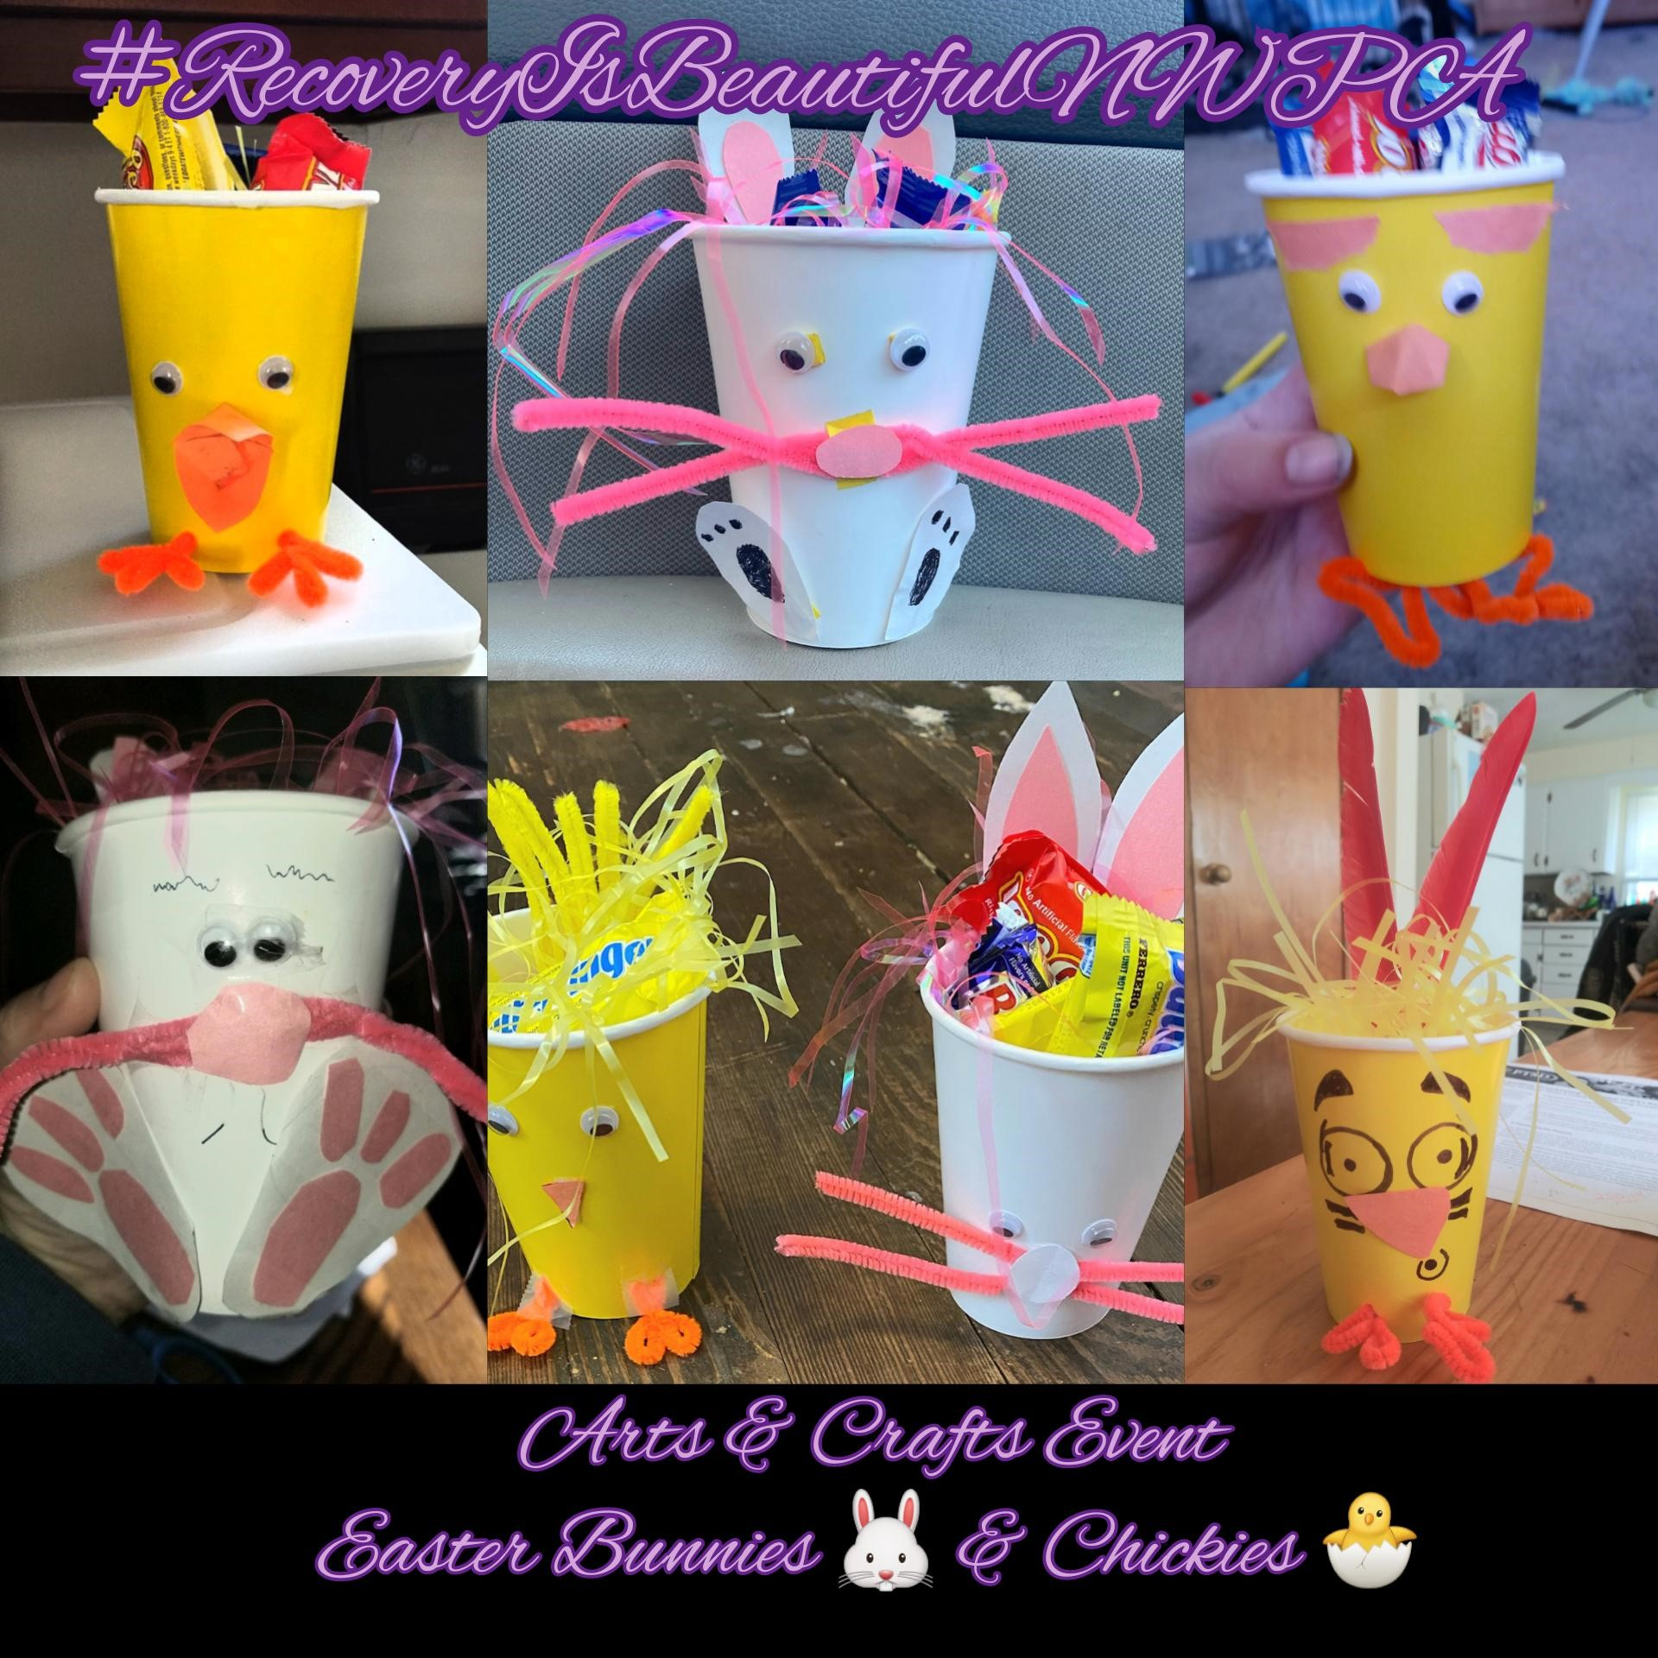
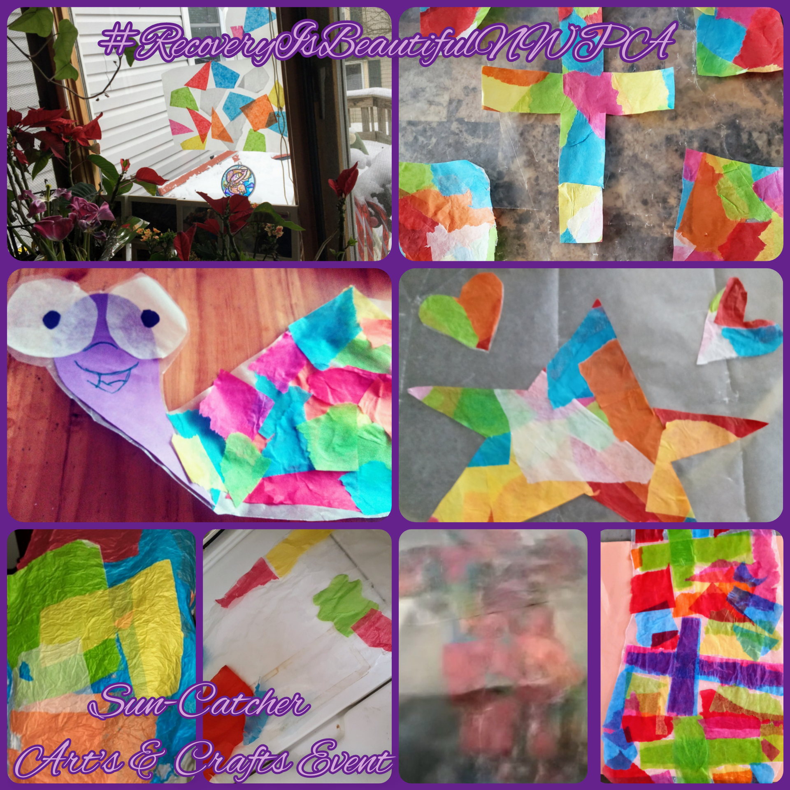
Program started in July 2020
Services have been offered in person and virtually to help folks stay connected
Transportation services
105 individuals have been engaged
164 family members have engaged
Recovery Capital through Advocacy/Community: Vigil of Hope, Celebrate Recovery, Out of the Darkness, Ride your Pride
Recovery Capital through Family/Social: Family Zoo Day, Conneaut Lake Park, Deer Park, Seawolves Game, Crawford Tuesday Walks, pumpkin painting, movie nights, Women’s Support Group, Crafting, meditation

Slide 13
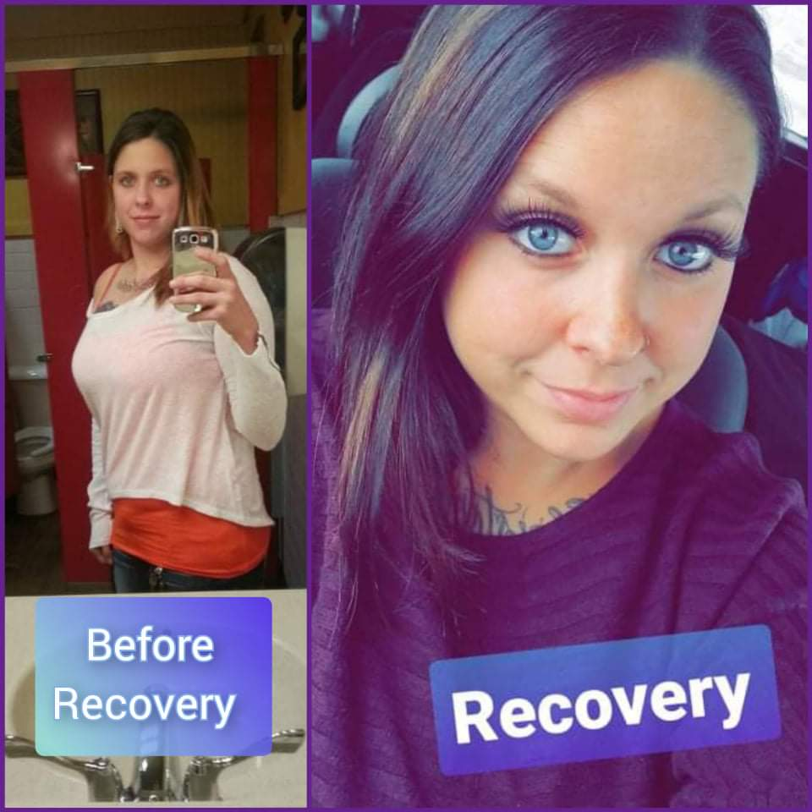

Slide 14
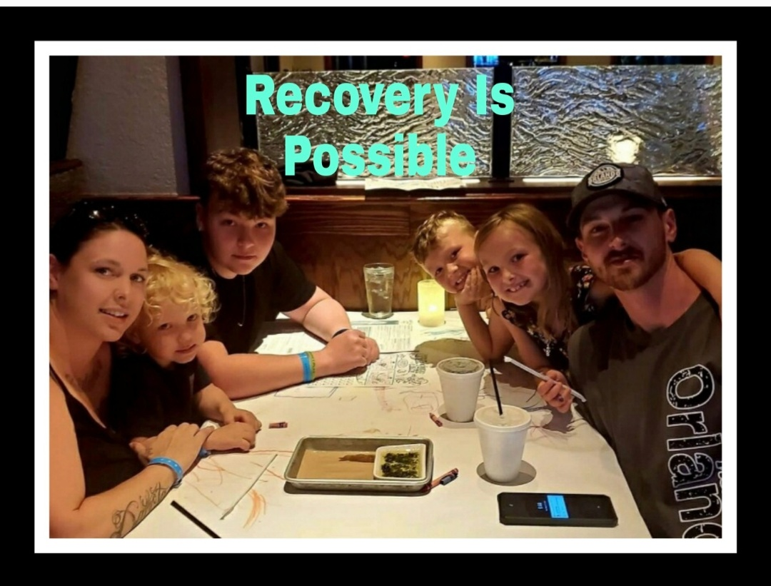

Slide 15
Hillary
Slides
It would also be great if you could share how you have grown your recovery capital over time and helped others, too.

Slide 16
Turning to Organizations
Why think about recovery capital in our organizations?
Research continues to demonstrate that if we do not build recovery capital internally…we can do harm externally
Language/Symbols
what’s SAID and
what is COMMUNICATED

Slide 17
What is this?

Slide 18
Let’s Look at Our Own FISHBOWL
The medical model that we may acculturate to – who sets the tone? Is this just a documentation issue?
Coats, Uniforms, Titles (and lack of title protection in some cases)
“Offenders” “Frequent Flyers” “Addicts”
Designated Spaces
A functional hierarchy may convey other things, too…
Let’s ask ourselves who and what is most represented in these structures?
When we say things like “diversity” – is there a standard that others are ‘diverse’ from? Resmaa Menakem — 'Notice the Rage; Notice the Silence' | The On Being Project - The On Being Project
Notes:
AA – 13% of population, 4% of doctors
Rising women – still less than ½, about 40% and VERY FEW leaders in hospitals and departments (16%)
Why Aren't More Women in Health Care Leadership Roles? | For Better | US News
Figure 18. Percentage of all active physicians by race/ethnicity, 2018 | AAMC

Slide 19
What we KNOW Labels influence:
Interpreting behavior
Critical thinking about assessment and planning
Care conveyed and interactions
Others’ perceptions

Slide 20
What we KNOW Labels influence:
Individual’s perception of themselves and their options
Future opportunities
“In” and “Out” Groups – with potentially deadly consequences
Socially “acceptable” behavior and choices
Help Seeking

Slide 21
What about Documentation?
Documentation is our vehicle to communicate to ourselves and to one another, it is generally geared to professionals, though this is changing.
Generally, the physician lead (note titling!) has an opportunity to model here
Example: do you use the term “patient” or use the person’s first name? Are you accurate in how your charting reflects the larger course of care?
Stigma is infectious in this context
Research has found it shapes approach to care: Do Words Matter? Stigmatizing Language and the Transmission of Bias in the Medical Record - PubMed (nih.gov)
“Messages” can clearly connote if a person is a ‘good’ or ‘bad’ ‘patient’ – same with staff
“Messages” can clearly connote judgment of a person’s needs or status
Individuals can be HARMED
When they read it -> how does it change relationship or help seeking -> how does this ripple?
When they are ‘outed’ in some way
When it impedes their safety (e.g., insurance benefits)
When it reduces their choices
Notes:
This isn’t just our setting – same with education or other ‘pass on’ type of context

Slide 22
Alternatives
Addict, Alcoholic, Junkie -> person with substance use disorder, person dealing with alcohol use disorder, etc.
Drug abuse -> harmful use, use
Clean -> abstinent, not using drugs, maintaining medications safely
Dirty -> actively using drugs, testing positive for drugs
Former addict -> in recovery
“good” -> engaged, working their program, motivated
Opioid replacement -> MOUD (MAT?)

Slide 23
Alternatives
IV Drug User, Junkie -> person who injects drugs
Abuser or User -> PERSON who/with, etc.
“User” – where else have you heard that?
Medication Assisted Treatment? Medication? Treatment?
“Bup” ->buprenorphine.
Female -> women, woman, person
Detox -> medically monitored withdrawal/support, etc.
NAS baby/NICU baby, etc. -> baby impacted by _____. Family with a baby currently ____.

Slide 24
What if We Conveyed to EVERYONE…

